Slide 1
DATA and WORKFLOWS

Slide 2
Data Life Cycle
Discovery
Upload
Data Commons Repository (DCR), Elasticsearch
Discovery Environment, iCommands, Cyberduck
Metadata
Publication
Add, delete, copy; metadata templates; bulk metadata
Analysis
Data Commons Repository (DCR), NCBI-SRA
Discovery Environment, Atmosphere, Agave API, BisQue, DNA Subway
Sharing
Community Data folders, Data Commons, quick share links
Notes:
Ramona
CyVerse supports data management throughout the data life cycle, including metadata, publication, and discovery
datacommons.cyverse.org

Slide 3
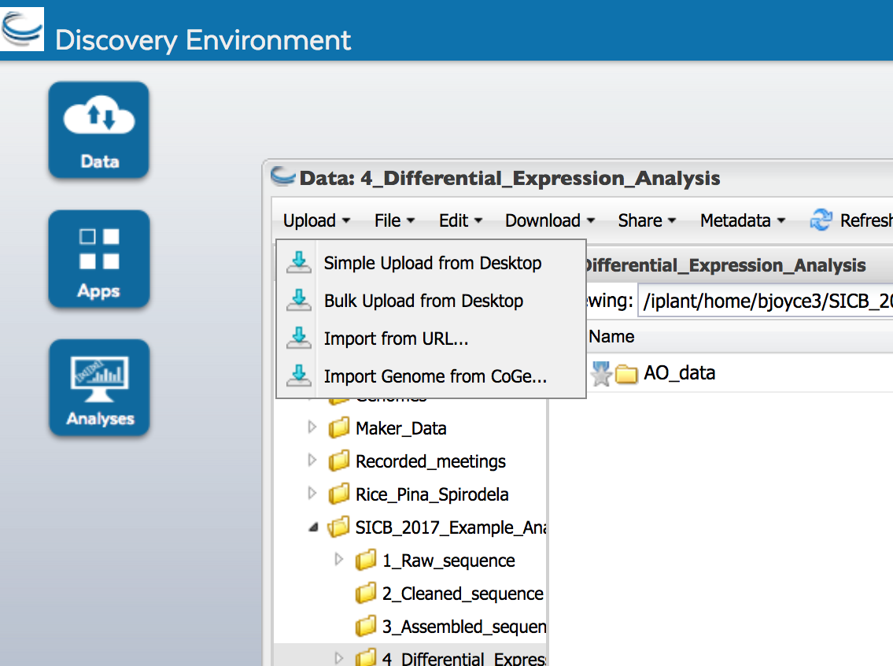
Access the Data Store
Discovery Environment
CyberDuck
iRODs iCommands
Upload & download files <2GB
Share, organize, edit data
Add metadata and templates
Publish data
Upload & download files of any size
Transfer data between CyVerse and other locations
Sync data with local drive
Upload & download files of any size
Share & organize data
Add metadata
Sync data with local drive
POWER
EASE

Slide 4
Data Dissemination: NCBI SRA Submission Pipeline
FASTQ file import and compression
Create SRA Submission Packages
from DE File menu
Create / Update NCBI BioProjects
2 metadata templates
Discovery Environment
Create NCBI BioSamples
10 metadata templates
Enter SRA Library metadata
1 metadata template
Validate package and transfer to SRA
submission apps (Aspera Connect)
User receives notification from SRA
Can retrieve SRA report, correct, resubmit
report retrieval app
Notes:
Upendra - Updated on 16/11/16
SRA submission is required for most scientific publications that include sequence data
Users create or update bioprojects, create biosamples, submit, can correct errors and resubmit within the DE if needed
Significantly lowers user’s technical issues with: data transfers, data compression, SRA metadata requirements, submission package assembly, error correction
Workflow Summary:
SRA Submission Pipeline: This workflow enables iPlant users to make submissions to the NCBI Sequence Read Archive (SRA). Submissions include compressed fastq files and an XML metadata file, organized into a submission package. A tutorial is available on the iPlant wiki. Step 1 Upload compressed sequence files into the iPlant Discovery Environment (DE). Step 2 Create submission package folders and add compressed sequence files. Step 3 Add metadata to every folder in the submission package. Step 4 In a 2-stage process, select the appropriate SRA Submission App to first validate the submission package and then, after successful validation, to submit to the SRA. Step 5 The submission package will be validated by the SRA system and email notifications will be sent by the SRA to the contact email added in the BioProject metadata to confirm successful submission, or to communicate submission error Step 6 If error correct SRA-detected errors and resubmit.

Slide 5
Data Publication: Data Commons
Organize dataset
Add DataCite metadata and Readme file
Discovery Environment
Data Commons
Request DOI
Validation by Data Commons curators
Data available to public
datacommons.cyverse.org
Notes:
Ramona

Slide 6
Overview of Genomics Workflows
Sequence Read Processing
Data Publication
HTProcess
SRA Submission
Data Commons
Assembly
Genome
Transcriptome
Variation Analysis
Assembly Analysis
Genome Annotation
Association
Association Pipeline
Validate Pipeline
RNA-Seq
Methylation
Discovery Environment
Atmosphere
Agave API
Notes:
Liya
changes: 1. switch the positions of SRA and Association; 2. Deleted link from Assembly to SRA; 3. Added link from Sequence to SRA; 4. Deleted link between Assembly and Association; 5. Renamed two RNA-Seq pipelines; 6. Re-ordered color-code labels
Throughout Workflow slides, be clear about whether or not a user can run this tool today - summarized in table at end of this section
Explain tools are in different platforms- DE/Agave means it can run via the DE or the Agave API
This presentation is focused on genomics area. We have worked on applications in other domains.

Slide 7
RNA-Seq 1: Differential Expression
Aligners
TopHat2, STAR*, HISAT2*
Assembly
Cufflinks2, StringTie*
Discovery Environment
Differential expression
Cuffdiff2, DESeq2*, Ballgown, edgeR, GFold
Atmosphere images
Quantification
RSEM, HTSeq, Bam_to_counts, kallisto, Salmon,
Sailfish, eXpress
Annotation
Trinotate*
Discovery
Environment
Atmosphere
Both
(DE & Atmo)
* New additions
Notes:
Kapeel-
CyVerse offers the most updated suite of tools for doing RNA seq data analysis. The current ecosystem of RNA seq tools ( HISAT2, stringtie, Kallisto etc) show improvement in speed and accuracy over the traditional Tuxedo suite. All the tools are either present on a atmosphere image and/or DE as mentioned in the slide.

Slide 8
RNA-Seq 2: High Throughput Process Apps
For handling large groups of data and easier workflow management. Files are managed as a group or library contained in a single directory.
HTProcess Read Cleanup Workflow
FastQC
Trimmomatic
FastQC
Discovery Environment
HTProcess Tuxedo Workflow
HTProcess TopHat 2
HTProcess TopHat-2 (HPC-Agave)
HTProcess Cufflinks
HTProcess CuffMerge
HTProcess
CuffDiff
Discovery
Environment
Atmosphere
Both
(DE & Atmo)
* New additions
Notes:
Ramona ADD AGAVE COLOR TO FONT; ADD A NOTE THAT THE SAME APPS ARE AVAILABLE AS NON-HTP
This pipeline helps minimize downstream handling by grouping reads into directories, with metadata and file names stored in an accompanying manifest file, as the data moves through multiple steps of analysis.
The first two steps in the HTProcess Pipeline are for evaluating read files, cleaning them up, and rechecking them.
The Tuxedo portion of the pipeline is now finished, which allows users to run a complete RNASeq differential expression analysis using the HTProcess tool set.
Guide for the first box: https://wiki.cyverse.org/wiki/display/TUT/Cleaning+up+your+reads+with+the+HTProcess+Pipeline
As far as I can tell, there is no guide for the second box.
EDITING NOTE: For each white box, there seems to be a transparent box with a black border on top. To edit the text in the white boxes, select the box, move it out of the way. This moves the transparent box off the lower boxes (there are multiple text boxes under the transparent box). Edit the text. Put the transparent box back in place.

Slide 9
RNA-Seq 3: Multifactorial pairwise comparisons
For doing multiple pairwise comparisons of RNA-Seq data for differential gene expression analysis
Read cleanup
Trim-galore
Target file
Differential gene expression
DESeq2/edgeR (multifactorial pairwise comparisons)
DESeq2 output
Aligner
BWA
Discovery Environment
edgeR output
Read counting
HTSeq
Raw counts
Discovery
Environment
Atmosphere
Both
(DE & Atmo)
* New additions
Notes:
Upendra - new
edgeR/DESeq2 (multifactorial pairwise comparisons) allows multifactorial pairwise comparison of RNA-Seq data for differential gene expression analysis. It provides tools to generate descriptive and diagnostic graphs, to run the differential analysis with the edgeR package, and export the results into easily readable tab-delimited files. It also facilitates the generation of an HTML report that displays all the figures produced, explains the statistical methods, and gives the results of the differential analyses
https://wiki.cyverse.org/wiki/pages/viewpage.action?pageId=28115142
https://wiki.cyverse.org/wiki/display/DEapps/edgeR+%28multifactorial+pairwise+comparisons%29+in+DE

Slide 10
Evolinc: Identification and Evolutionary analysis of Long Non-coding RNA (LincRNA)
Aligners
TopHat-2.1.1
Evolinc-I output
Assemblers
Cufflinks-2.2.1
LincRNA
Evolinc-II-2.0
Discovery Environment
Atmosphere image
Merge
Cuffmerge2
LincRNA
Evolinc-I-2.0
Evolinc-I output
Discovery
Environment
Atmosphere
Both
(DE & Atmo)
* New additions
Notes:
Upendra - new ADD DESCRIPTIVE HEADINGS
Evolinc is a two-part workflow (Evolinc-I and Evolinc-II both version are currently at 2.0) to identify lncRNAs from an assembled transcriptome file (GTF output from Cuffmerge/Cuffcompare) and then determine the extent to which those lncRNAs are conserved in the genome and transcriptome of other species.
https://wiki.cyverse.org/wiki/display/TUT/Evolinc+in+the+Discovery+Environment
https://wiki.cyverse.org/wiki/display/TUT/Evolinc+using+Atmosphere

Slide 11
Genome Assembly
HTProcess Read Cleanup Workflow
FastQC
Jellyfish
Trimmomatic
FastQC
Discovery Environment
Whole Genome Assembly
AllPathsLG
SOAPdenovo-2
Velvet
Ray
Newbler
Spades
Genome Assembly Analysis
Assess assembly
Get correctness via GAGE
Compute contig stats
Snap-gene prediction
QUAST
Discovery
Environment
Atmosphere
Both
(DE & Atmo)
* New additions
Notes:
Ramona (MARTHA AND UPENDRA WILL CREATE NEW UPDATED SLIDE)
CyVerse has available in the Discovery Environment applications important to the 3 main phases of whole genome assembly: read cleanup (essential to an accurate assembly); the most commonly used genome assemblers; and a set of tools for evaluating the resulting assemblies.
Tutorial for read cleanup: https://wiki.cyverse.org/wiki/display/TUT/Cleaning+up+your+reads+with+the+HTProcess+Pipeline
Tutorial for assembly: https://wiki.cyverse.org/wiki/display/TUT/Assembling+a+Genome
EDITING NOTE: For each white box, there seems to be a transparent box with a black border on top. To edit the text in the white boxes, select the box, move it out of the way. This moves the transparent box off the lower boxes (there are multiple text boxes under the transparent box). Edit the text. Put the transparent box back in place.

Slide 12
Genome Annotation: WQ-MAKER in Jetstream
Worker
MAKER
Worker
Augustus
SNAP
Worker
Exonerate
Master instance
WQ-MAKER Jetstream Image
MAKER output
Worker
BLAST
RepeatMasker
Worker
cctools
Worker
iCommands
Worker
In collaboration with the Douglas Thain lab (http://www3.nd.edu/~dthain/)
Notes:
Upendra - Updated 16/11/16
This describes the steps involved in the MAKER pipeline for annotation genomes. This pipeline has been built into an image in Atmosphere. Using this pipelines users can now run MAKER simultaneously on multiple chromosomes. This is done by launching multiple “worker” instances each of which will receive the MAKER executables as well as individual input sequences to annotate. Output from MAKER runs from each worker instance is brought back to the MASTER instance.
Previously we had incorporated MAKER-P into Atmosphere. This runs one chromosome a time. So each annotation run took a long time.
Here you see the schematic of WQ-MAKER in its Atmosphere image showing the steps involved in MAKER-P being distributed to and run within multiple workers, instances each of which will run a separate job, simultaneously. WQ-MAKER speeds up the annotation run significantly. Benchmark figure available on iPlant WQ-MAKER wiki page.
We are currently applying for XSEDE allocation on Jetstream, with which we can run unlimited number of WQ-MAKER instances in parallel, reducing the annotation run time even further.

Slide 13
Expression Data Analysis Pipeline
by CyVerseUK
Differential Expression
GP2S, Gradient Tool
Clustering / Biclustering
BHC, TCAP, Wigwams
Network Inference
CSI, hCSI, oCSI
Discovery Environment
Transcription Factor Motif Enrichment
HMT, MEME-LaB
Discovery
Environment
Atmosphere
Both
(DE & Atmo)
* New additions
Notes:
Bo Gao
These apps were integrated by CyVerseUK. They are available in the US Discovery Environment running on the Condor cluster. In future, they will be available through Agave to execute at TACC and on UK resources.
A description of this pipeline is at http://cyverseuk.org/applications/expression-data-analysis-pipeline/. For more details, please see our tutorial at: https://github.com/cyversewarwick/expression_tutorial

Slide 14
Metagenomics Using QIIME 1
Check mapping file + metadata
validate_mapping_file
Split libraries + quality filtering (Illumina)
split_libraries_fastq
Discovery Environment
Pick Operational Taxonomic Units (OTUs)
pick_open_reference_otus
Atmosphere images
Analyze diversity
core_diversity_analyses
Make Emperor - 3D PCoA plots
make_emperor
Discovery
Environment
Atmosphere
Both
(DE & Atmo)
* New additions
Notes:
Joslynn - These are the available apps in DE, checking
11/12 - Thanks! I shortened the items and check them in Atmosphere (joslynn)

Slide 15
Transcriptome Assembly
HTProcess Read Cleanup Pipeline
HTProcess Read Cleanup Workflow
FastQC
Jellyfish
Trimmomatic
FastQC
FastQC
Trimmomatic
FastQC
Transcriptome Assembly
Discovery Environment
Trinity
SOAPdenovo- Trans
Oases
Bayesembler
Cufflinks
Transcriptome Assembly Analysis
RNA-QUAST
GAGE to get correctness
Compute contig stats
CD-HIT-EST
Annotate transcripts
Decode transcript
Discovery
Environment
Atmosphere
Both
(DE & Atmo)
* New additions
Notes:
Upendra - Need to make a new slide as i cannot edit this slide DITTO
Transcriptome assembly requires the same key functions: read cleanup (essential to an accurate assembly); assembly; post-assembly analysis.
All are well-represented in the DE.
Recent improvements have been focused on improving the documentation for these.

Slide 16
Non-model organism de novo transcriptomics
Raw FASTA assessment, adapter removal, trimming
FastQC + Scythe + Sickle
De novo assembly of reads
Trinity
Discovery Environment
Assessment of assembly
rnaQUAST
Atmosphere images
Differential gene expression
DESeq2 or EdgeR
Annotation of transcripts
Trinotate
Discovery
Environment
Atmosphere
Both
(DE & Atmo)
* New additions
Notes:
Blake - originally built for the Society for Integrative Biology (SICB) scientific community working on non-model invertebrate species (shrimp, crab, etc). Built originally before Jetstream, updated images and Docker files containing all of the analyses are being developed.

Slide 17
DNA Methylation Analysis
Genome Indexer
Bismark Genome Preparation
Bisulfite Sequence Aligner and Methylation Caller
Bismark BSMAP* GSNAP*
Discovery Environment
Methylation Reporter
Bismark Methylation Extractor ZED-align*
Differential Methylation Caller
BisuKit*
Discovery
Environment
Atmosphere
Both
(DE & Atmo)
* New additions
Notes:
Jawon
This workflow enables iPlant user to map bisulfite treated sequencing reads to a genome of interest and perform methylation analysis.
Step 1. Preparing reference genome, Genome preparation iPlant wiki
Step 2. Mapping reads and make methylation calls, Bismark iPlant wiki
Step 3. Generating comprehensive methylation analysis report, Methylation Extractor iPlant wiki

Slide 18
Association Analysis
Variant calling
SAMtools, GBS, EMS
Imputing
NPUTE
Discovery Environment
Agave API
Population structure
Structure, fastStructure, PCA
Association
GLM, MLM, EMMAX, MLMM, PLINK, FastLMM, GEMMA*, BayesR*
Discovery
Environment
Agave API
Both
(DE & Agave)
* New additions
Notes:
Liya
NPUTE, fastStructure, PCA, EMMAX, MLM are integrated through Agave and supported by the CSHL cluster
NPUTE is a parallelized version of nearest neighbor algorithm based missing SNP imputation. The parallelization allows testing different window sizes simultaneously
fastStructure and PCA are added as two alternative ways for estimating population structure.
EMMAX is another mixed model implementation if compared with TASSEL MLM
MLMM supports multi-loci mixed model analysis
General instructions
Step 1: Use GBS to call variants, output is in Hapmap format
Step 2: Use NPUTE to impute missing SNPs (first sub-step is to estimate optimum window size; second sub-step is to do imputation with the optimum window size)
Step 3: Use Structure to estimate population structure (use numericalTransform to convert to correct format for Structure and Association apps)
Step 4: Do Association analysis

Slide 19
Variant Caller Workflow
Aligners
BWA-MEM, BWA-ALN
Reference prep
Picard, SAMtools
Discovery Environment
Agave API
Variant callers
GATK UnifiedGenotyper, Platypus.py callVariants, SAMtools mpileup
Discovery
Environment
Agave API
Both
(DE & Agave)
* New additions
Notes:
James Carson - Updated Oct 2016 - CHANGE APP FONT TO BOTH COLOR (MARTHA)
This variant caller pipeline is currently available from both the DE and command line via Agave.
It is optimized, and running on Lonestar5
Source code and tutorial are available at https://github.com/ianimal/pipelines

Slide 20
Validate Workflow
Extensible, scalable testing of tool accuracy and precision
Simulate Apps
Industrial scale GWAS simulation files from Syngenta, AlphaSim
Associate and Predict Apps
FaST-LMM, GEMMA, Plink, QxPak, BayesR, GenSel, RidgeRegression
Discovery Environment
Agave API
Winnow App (calculate signal/noise)
Python code, stats libraries, D. Hand’s metrics
Demonstrate Apps (human-readable graphics and tables)
Python and R code, R ggplot2
Discovery
Environment
Agave API
Both
(DE & Agave)
* New additions
Notes:
Ann S (MARTHA - MAKE FONT BOTH)
this workflow allows people who want to choose the optimal method for gwas and prediction to measure the accuracy and precision of apps
comparing app accuracy and precision from scratch is a huge effort, so we have provided pre-installed, extensible apps and access to compute that scales with increasing needs through this workflow
this workflow is usable now at the scale method developers will need
all the components are also dockerized (and available from dockerhub), with the individual docker components assembled into a workflow using the new endofday workflow system
credits: Ann Stapleton, all the UNCW students, Joe Stubbs at TACC, help from Rion, John, Roger...

Slide 21
Comparative Genomics
Raw reads assessment, trimming
FastQC, Scythe, Sickle
Genome in NCBI or FTP site
Genome assembly
AllPaths, Velvet, etc.
Genome integration into CoGe
LoadGenome
Discovery Environment
Genome annotation
Maker
Integration of functional and diversity data with genome
FlowGe
CoGe
Data publication
Data Commons
Syntenic analysis, visualize, compare to other sequences
SynMap, GenomeView, GEvo
Discovery
Environment
Atmosphere
CoGe
Notes:
Blake
PLEASE COLOR CODE THE FONT FOR THE DE APPS

Slide 22
Species Distribution Modeling
Georeferencing and Alignment
Geospatial Data Abstraction Library (GDAL) *
Surface Models
Geographic Resource Analysis Support System (GRASS) *, System for Automated Geospatial Analysis (SAGA) *
Discovery Environment
Atmosphere images
Zonal Statistics
Quantum Geographic Information System (QGIS) *
Species Distribution Models (SDM)
RStudio-Server (R) *
Discovery
Environment
Atmosphere
Both
(DE & Atmo)
* New additions
Notes:
Tyson MARIAH, CHANGE THE “BOTH” COLOR TO WHATEVER WE DECIDE SHOULD BE USED

Slide 23
In the Works
Phenomics workflow support
Image data management and analysis
Geographic information systems
To discuss your phenomics workflow needs, contact info@cyverse.org.

Slide 24
Workflows: Quick Reference Guide
Workflow | Platform | Limits | Documentation
DATA
Data Management Life Cycle | All | -- | Data Commons Repository
GENOMICS
SRA Submission | DE | -- | Documentation and tutorial
RNA Seq 1 Differential Expression | DE, Atmo | -- | Tutorial
RNA Seq 2 HT Process | DE, Agave | 150 GB input data max | Documentation
RNA Seq 3 Multifactorial Pairwise Comparisons | DE | -- | DESeq2 tutorial edgeR tutorial
Expression Data Analysis Pipeline (UK) | DE | -- | Documentation Tutorial
Evolinc | DE, Atmo | -- | DE tutorial Atmo tutorial
Genome Assembly | DE, Agave | -- | Cleanup tutorial Assembly tutorial
Genome Annotation WQ-MAKER | Jetstream | -- | Tutorial
Metagenomics QIIME | DE, Atmo | -- | Atmo tutorial
DE - Discovery Environment
Atmo - Atmosphere
Agave - Agave API
Notes:
Martha
This version of the table, with links to documentation, is for the online versions of the brochure. (Links have been updated from iplant to cyverse.)

Slide 25
Workflows: Quick Reference Guide (cont.)
Workflow | Platform | Limits | Documentation
GENOMICS (cont.)
Transcriptome Assembly | DE, Agave | 48 hrs run time max | Tutorial
Non-model Organism Transcriptomics | DE, Atmo | --
Methylation Analysis | DE, Agave | -- | Bismark Genome Preparation Bismark Bismark Methylation Extractor
Association Analysis | DE, Agave | -- | Documentation and tutorials
Variant Caller | DE, Agave | 48 hrs run time max | Documentation
Validate | Atmo, Agave | -- | Documentation
GEOSPATIAL DATA
Species Distribution Modeling | DE, Atmo | --
DE - Discovery Environment
Atmo - Atmosphere
Agave - Agave API
Notes:
Martha
This version of the table, with links to documentation, is for the online versions of the brochure. (Links have been updated from iplant to cyverse.)

